Slide 1


CSA4302 - INTERNET PROGRAMMING
CareSync Medicine Tracker
Family Medication & Adherence Tracker
Team members:
Kishore P (192121074)
Jaya Harish J (192462001)
Syed Mosin Rayan M (1925260323)
Project guide:
Dr T Kosalairaman
Notes:
• Welcome the panel and state the project title and what it addresses: medication reminders plus family caregiver coordination.
• Introduce the team and guide.
• Outline the flow: problem, objectives, literature, solution, modules, architecture, tools, next steps, conclusion.

Slide 2
Introduction
1
MedRemind & CareLink is a family medication and adherence tracking system designed to simplify medicine management.
2
It helps users schedule medications and receive timely reminders for their prescribed doses.
3
The system allows patients to record dose confirmations and track their medication history.
4
It alerts designated family caregivers about missed doses, with the patient's consent.
5
It also provides medication stock tracking and adherence reports to improve coordination between patients and caregivers.
Notes:
• Five objectives, each tied to a concrete check we can demonstrate in the working system.
• Stress the consent requirement: caregivers are notified only if the patient has agreed.
• These objectives map directly to the features on the Proposed Solution slide.

Slide 3




Problem Statement
Forgotten schedules
Multiple prescriptions
PROBLEM ADDRESSED
Families lack one coordinated place to schedule medicines, confirm doses, spot missed doses, and keep caregivers informed.
Doses are easy to miss when routines change or reminders are scattered.
Different medicines, doses and timings are hard to keep track of.
Refill tracking
Caregiver visibility
Supply runs low without a clear view of remaining stock.
Family caregivers have no timely view of whether a dose was taken.
Notes:
• Four everyday challenges: forgetting schedules, juggling several prescriptions, tracking refills, and keeping caregivers informed.
• These are usually handled with separate alarms, notes and phone calls.
• Define the problem: no single, coordinated system for patient and caregiver.

Slide 4
Objectives
1
Schedule and manage medication reminders
Measure: reminders fire at their configured times
2
Record patient-reported dose confirmations
Measure: each dose is logged as taken or pending
3
Detect overdue, unconfirmed doses
Measure: overdue doses flagged after a set grace window
4
Notify designated caregivers with appropriate consent
Measure: alerts go only to consenting caregivers
5
Track medication stock and adherence history
Measure: stock and dose history viewable per patient
Notes:
• Five objectives, each tied to a concrete check we can demonstrate in the working system.
• Stress the consent requirement: caregivers are notified only if the patient has agreed.
• These objectives map directly to the features on the Proposed Solution slide.

Slide 5
Literature Survey
Source | Main contribution | Gap / limitation
Kim et al., 2026 [1] ACADEMIC · REVIEW (J. Med. Syst.) | Meta-analysis of 26 RCTs: apps improved adherence, notably with advanced reminders and data sharing | Aggregate evidence; no concrete caregiver-escalation design
Zhou, 2025 [5] PREPRINT (arXiv) · NOT PEER-REVIEWED | Adhera: caregiver-focused smart pill organizer with a shared adherence dashboard | Hardware-dependent; small sample, simulated-condition testing
Paul et al., 2024 [3] ACADEMIC · HARDWARE PROTOTYPE (HELIYON) | Smart reminder kit with repeated phone-call alerts and health sensors for seniors | Needs dedicated hardware; calls target the patient, not family caregivers
Catindoy et al., 2024 [4] ACADEMIC · CONFERENCE (IEEE ICVEE) | Android app for entering medicines, reminders and health tips | Abstract describes no caregiver notification or escalation
Hartch et al., 2023 [2] ACADEMIC STUDY OF A COMMERCIAL APP (MEDISAFE) | Two-week pilot (N=10): higher medication self-efficacy; reminders were the most-used feature | Small single-arm study; refill reminders and caregiver sharing were rarely used
Notes:
• Five verified sources: four peer-reviewed publications and one arXiv preprint, labelled as such.
• Medisafe is the only commercial app: it appears here through a published academic evaluation [2].
• Common gap: reminders are well covered, but caregiver escalation for unconfirmed doses without extra hardware is not a focus. That is where this project sits.

Slide 6






Proposed Solution
A centralized dashboard where patients confirm doses and caregivers stay informed.
Medication scheduling
Patient reminders
Dose confirmation
Doses and timings per person
Alerts at each dose time
Patient confirms each dose
Missed-dose detection
Caregiver SMS / email
Refills & reports
Unconfirmed doses flagged overdue
Sent to consenting caregivers
Stock levels and adherence history
Notes:
• One dashboard serves both roles: patients schedule and confirm, caregivers receive alerts and see history.
• Core loop: schedule, remind, confirm, detect missed doses, notify caregiver.
• Refill tracking and adherence reports give the family ongoing visibility.

Slide 7
Modules Overview
MODULE 1
MODULE 2
MODULE 3
Patient & Medication Management
Reminders & Dose Adherence Tracking
Caregiver Coordination & Notifications
Patient profiles, medicines, dose schedules and stock levels.
Dose reminders, confirmations, missed-dose detection and history.
Consent-based SMS and email alerts to family caregivers.
Patient and medicine setup feeds reminders, and missed doses trigger caregiver alerts.
Notes:
• The system is split into three modules that follow the data and event flow.
• Module 1 holds the records: patients, medicines, schedules and stock. Module 2 uses those schedules to remind, record confirmations and detect missed doses. Module 3 acts on missed doses by alerting caregivers who have consented.
• The next three slides explain each module: what it does, and what it produces.

Slide 8
Patient & Medication Management
MODULE 1 OF 3
Patient profiles
Medication records
MODULE PURPOSE
Creates the records the other modules depend on: who is cared for, what they take, and when.
KEY OUTPUT
Patient profiles, medication schedules and stock levels.
Add and manage the people whose medicines are tracked.
Name, dose, form and instructions for each prescription.
Dose schedules
Stock & refills
Timings and frequency per medicine, with start and end dates.
Remaining quantity per medicine with a low-stock level.
Notes:
• Module 1 is the foundation: every reminder, confirmation and alert refers to a record created here.
• Four functions: patient profiles, medication records, dose schedules, and stock with refill tracking.
• Supports objectives 1 and 5: scheduling reminders, and tracking medication stock.
• Data is stored in MongoDB and accessed through the Express backend.

Slide 9
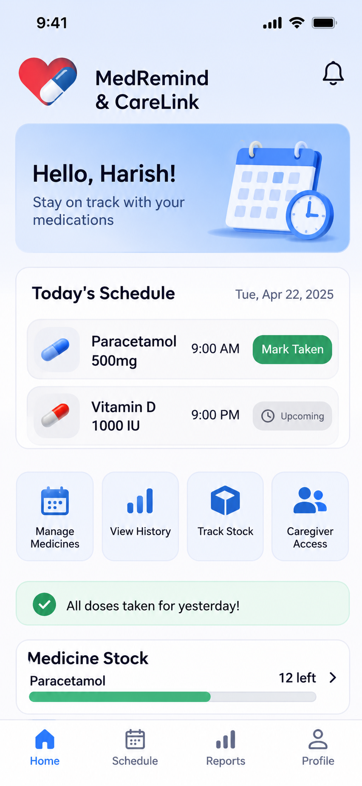
Patient & Medication Management
Sample Screenshot
MODULE 1 OF 3
Notes:
• Module 3 handles everyone other than the patient. A caregiver is linked to a patient and the patient records consent.
• When Module 2 flags an overdue dose, the system checks consent first, then sends an SMS (Twilio) and an email (Nodemailer).
• Supports objective 4: notify designated caregivers with appropriate consent.
• Each alert is recorded so the event is visible in the history.

Slide 10
Reminders & Dose Adherence Tracking
MODULE 2 OF 3
Patient reminders
Dose confirmation
MODULE PURPOSE
Runs the daily loop: remind, confirm, and flag any dose that stays unconfirmed.
KEY OUTPUT
Dose log (taken / pending / missed), adherence history and reports.
An alert reaches the patient when a dose is due.
The patient marks each dose as taken; the status is logged.
Missed-dose detection
Adherence history
Unconfirmed doses are flagged overdue after a grace window.
Taken, pending and missed doses viewable per patient.
Notes:
• Module 2 is the daily loop. Node-Cron checks for due doses and the backend sends the reminder.
• The patient confirms each dose; a dose still unconfirmed after the grace window is marked overdue and passed to Module 3.
• Supports objectives 1 to 3 and 5: reminders, confirmations, overdue detection and adherence history.
• The result is a dose log that both the patient and consenting caregivers can review.

Slide 11
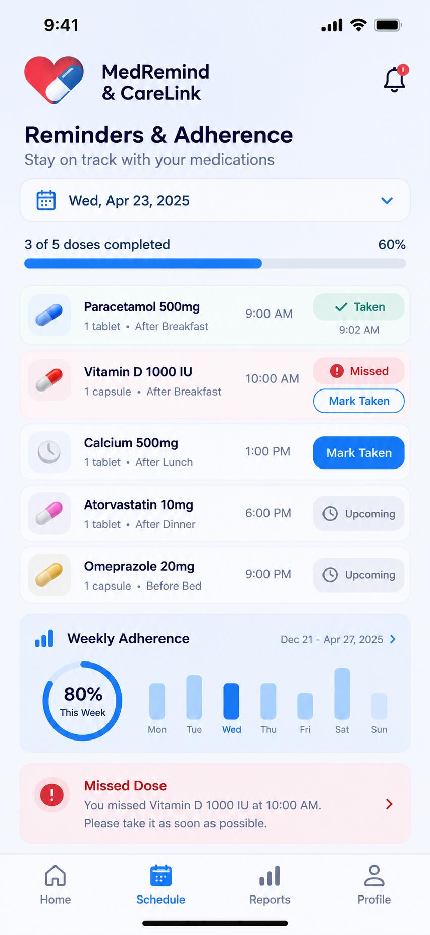
Reminders & Dose Adherence Tracking
Sample Screenshot
MODULE 2 OF 3
Notes:
• Module 3 handles everyone other than the patient. A caregiver is linked to a patient and the patient records consent.
• When Module 2 flags an overdue dose, the system checks consent first, then sends an SMS (Twilio) and an email (Nodemailer).
• Supports objective 4: notify designated caregivers with appropriate consent.
• Each alert is recorded so the event is visible in the history.

Slide 12


Caregiver Coordination & Notifications
MODULE 3 OF 3
Caregiver linking
Consent control
MODULE PURPOSE
Keeps family caregivers informed, but only with the patient’s consent.
KEY OUTPUT
SMS and email alerts, a notification log and a caregiver dashboard view.
Link family caregivers to a patient's account.
Alerts go only to caregivers the patient has approved.
SMS & email alerts
Caregiver view
Twilio SMS and Nodemailer email when a dose is missed.
Caregivers see dose status, history and low stock.
Notes:
• Module 3 handles everyone other than the patient. A caregiver is linked to a patient and the patient records consent.
• When Module 2 flags an overdue dose, the system checks consent first, then sends an SMS (Twilio) and an email (Nodemailer).
• Supports objective 4: notify designated caregivers with appropriate consent.
• Each alert is recorded so the event is visible in the history.

Slide 13
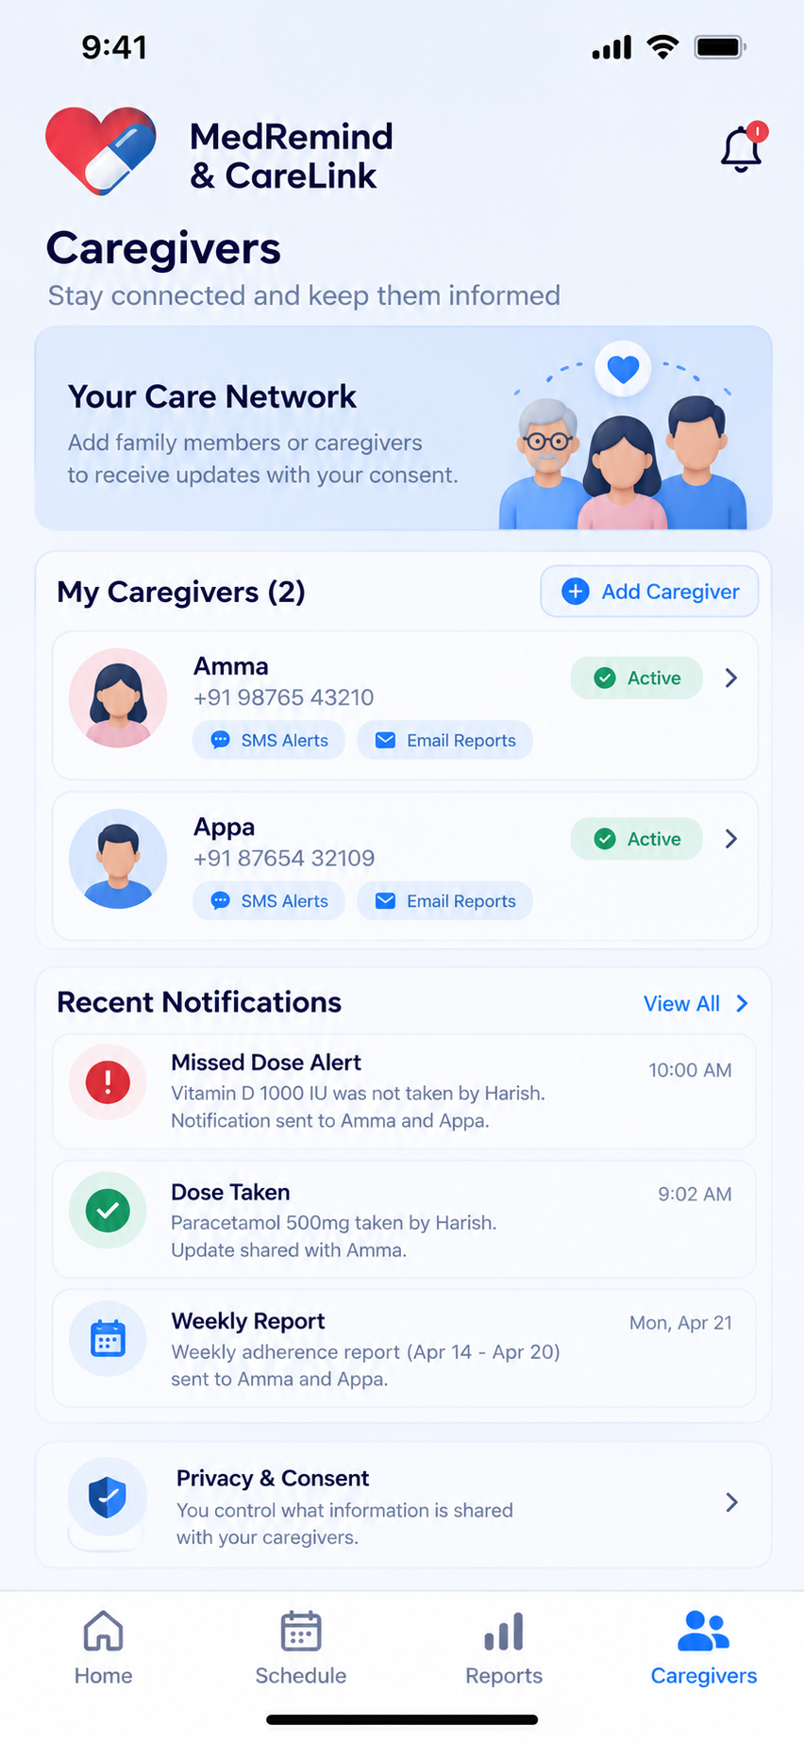
Caregiver Coordination &
Notifications
Sample Screenshot
MODULE 3 OF 3
Notes:
• Module 3 handles everyone other than the patient. A caregiver is linked to a patient and the patient records consent.
• When Module 2 flags an overdue dose, the system checks consent first, then sends an SMS (Twilio) and an email (Nodemailer).
• Supports objective 4: notify designated caregivers with appropriate consent.
• Each alert is recorded so the event is visible in the history.

Slide 14
System Architecture
Patient / Caregiver
React Frontend
Node.js + Express Backend
MongoDB Database
Node-Cron
scheduled checks
Notification service
Twilio SMS · Nodemailer email
Schedule & adherence records
stored in MongoDB
Reminder flow
Node-Cron runs a check
Due doses found
Reminder sent to patient
Patient confirms dose
Adherence record saved
Missed-dose escalation
Dose unconfirmed
Grace window ends
Caregiver consent checked
SMS / email to caregiver
Event recorded
Notes:
• Top row is the request path: user, React frontend, Express backend, MongoDB.
• The backend runs Node-Cron checks, calls the notification service (Twilio SMS, Nodemailer email) and reads/writes schedule and adherence records.
• Two flows: normal reminders, and escalation when a dose stays unconfirmed past the grace window and the caregiver has consented.

Slide 15



Tools and Technologies
FRONTEND
BACKEND
DATABASE
React
Node.js, Express
MongoDB
SCHEDULING
NOTIFICATIONS
AUTHENTICATION
Node-Cron
Twilio SMS, Nodemailer
Telegram can be used
JWT, bcrypt, Google authentication
Notes:
• Technologies are grouped by purpose; the whole stack is JavaScript, so one language across frontend and backend.
• Node-Cron drives scheduled checks; Twilio sends SMS and Nodemailer sends email.
• JWT handles sessions and bcrypt hashes passwords. No hardware is part of this design.

Slide 16
Next Steps
UPCOMING WORK
1
Finalize requirements and database schema
IMMEDIATE FOCUS
2
Design patient and caregiver dashboards
Complete the database schema and Module 1 first. Reminders and caregiver alerts are then built on top of those records.
3
Build authentication and Module 1
4
Build Module 2: reminders and dose tracking
5
Build Module 3: caregiver alerts and refills
6
Integrate modules, test and run security checks
7
Prepare final report, demo and documentation
Notes:
• Seven upcoming stages, ordered as the build will proceed.
• Immediate focus: finalize the requirements and database schema, then build authentication and Module 1, since Modules 2 and 3 depend on its records.
• Integration, testing and security checks are kept as their own stage before the final report and demo.
• Review dates and status are placeholders to be agreed with the guide; no completed progress is claimed here.

Slide 17
References
RESEARCH PAPERS AND SYSTEMS
TOOL DOCUMENTATION
[1] S. K. Kim, S. Y. Park, H. R. Hwang, S. H. Moon, and J. W. Park, “Effectiveness of mobile health intervention in medication adherence: A systematic review and meta-analysis,” J. Med. Syst., vol. 49, art. no. 13, 2025, doi: 10.1007/s10916-024-02135-2.
[2] C. E. Hartch, M. S. Dietrich, and D. P. Stolldorf, “Effect of a medication adherence mobile phone app on medically underserved patients with chronic illness: Preliminary efficacy study,” JMIR Form. Res., vol. 7, art. no. e50579, Dec. 2023, doi: 10.2196/50579.
[3] L. C. Paul et al., “A smart medicine reminder kit with mobile phone calls and some health monitoring features for senior citizens,” Heliyon, vol. 10, no. 4, art. no. e26308, Feb. 2024, doi: 10.1016/j.heliyon.2024.e26308.
[4] V. O. Catindoy et al., “Medication reminder and tracker application,” in Proc. 7th Int. Conf. Vocational Educ. Elect. Eng. (ICVEE), Oct. 2024, pp. 341–347, doi: 10.1109/ICVEE63912.2024.10823699.
[5] Z. Zhou, “Adhera: A human-centered health informatics solution for reducing informal caregiver burden through improved medication adherence,” arXiv:2512.03878, 2025 (preprint). [Online]. Available: https://arxiv.org/abs/2512.03878
[6] Meta Platforms, Inc., “React documentation.” [Online]. Available: https://react.dev (accessed Oct. 9, 2026).
[7] OpenJS Foundation, “Express: Fast, unopinionated, minimalist web framework for Node.js.” [Online]. Available: https://expressjs.com (accessed Oct. 9, 2026).
[8] MongoDB, Inc., “MongoDB documentation.” [Online]. Available: https://www.mongodb.com/docs/ (accessed Oct. 9, 2026).
[9] Twilio Inc., “Programmable messaging.” [Online]. Available: https://www.twilio.com/docs/messaging (accessed Oct. 9, 2026).
[10] A. Reinman, “Nodemailer.” [Online]. Available: https://nodemailer.com (accessed Oct. 9, 2026).
[11] M. Jones, J. Bradley, and N. Sakimura, “JSON Web Token (JWT),” IETF, RFC 7519, May 2015. [Online]. Available: https://datatracker.ietf.org/doc/html/rfc7519
Notes:
• Conclusion: CareSync addresses missed doses and caregiver blind spots with one coordinated system: scheduling, reminders, dose confirmation, missed-dose detection and consent-based alerts.
• Scope is software only (React, Node.js, Express, MongoDB); no hardware is needed.
• Sources [1]-[4] are published academic work; [5] is an arXiv preprint and is flagged as such.
• [6]-[11] are official documentation or standards for the tools on the Tools slide.

Slide 18
Thank you
Notes:
• Conclusion: CareSync addresses missed doses and caregiver blind spots with one coordinated system: scheduling, reminders, dose confirmation, missed-dose detection and consent-based alerts.
• Scope is software only (React, Node.js, Express, MongoDB); no hardware is needed.
• Sources [1]-[4] are published academic work; [5] is an arXiv preprint and is flagged as such.
• [6]-[11] are official documentation or standards for the tools on the Tools slide.

